Slide 1

Artificial Intelligence and Sentencing
An exploration of AI to predict sentencing for the Papua New Guinea Judiciary
Supervisors:
Rizwan Ahmed
Michael Thompson
Alison Holt
Andrew Pritchard
Mehta Komal
Michael Singh

Slide 2
Agenda
01
Introduction
We introduce the team and discuss the projects scope, goals and objectives. We also discuss the risks of this project.
02
Scraping
We discuss the problem of getting to the data we required for this problem
03
Metadata
Komal takes you though metadata as it relates to the Papua New Guinea judiciary, and our project.
04
Website
Michael discuses the website that makes use of the AI engine, as well as serving as a portal for more general use.
05
Artificial Intelligence
Andrew introduces you to neural networks and AI as well as the work done to make it useful for our project.

Slide 3

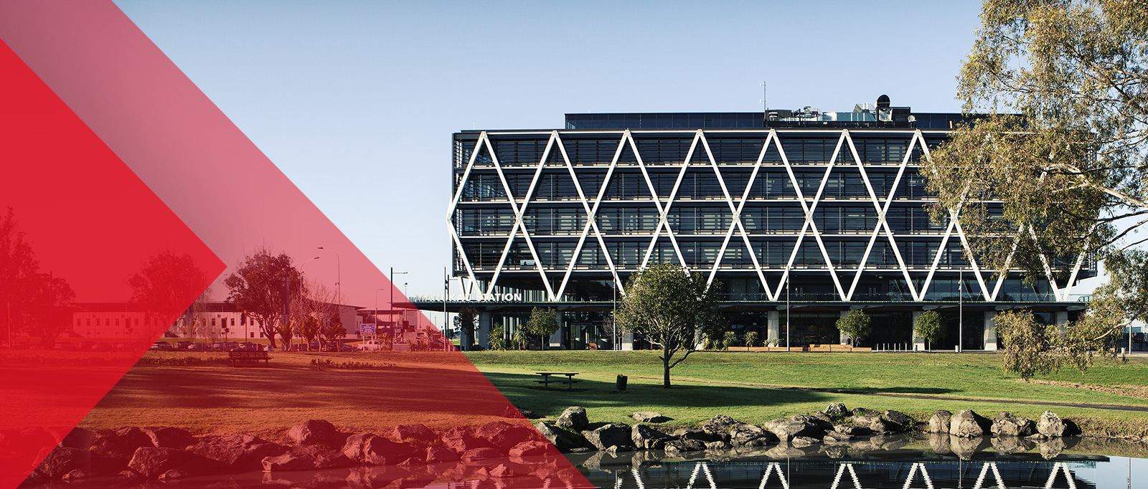



Our Team
A trio of intrepid souls united in their efforts to do amazing work
Michael Singh
Andrew Pritchard
Mehta Komal

Slide 4
Timeline
Aug-2-2019
Sep-2019
Nov-2019
Team Formation
Michael Joins
Neural Networks
4 of us come together to form a team
We bring Michael onboard to handle web development.
The initial networks are made, tuning to improve begins
Aug-5-2019
Sep-2019
Dec-2019
1st Client Meeting
Scraping Done
Project Demonstration
We get the initial rundown on the project, and begin dividing and assigning work
The initial data collection is completed to a useful level.
The project is as done as we can get, now we show it off.

Slide 5

Problem Statement
Judiciaries around the world are overburdened nowadays, so making use of emerging technology to alleviate this burden is the main thrust of this project

Slide 6
Scope
Extract data from the Paclii website for use
Design and Implement Website
Design and Train and Artificial Intelligence
Project Tasks
Analyze data and explore it for hidden insights into the problem
Examine Metadata in relation to the Judicial Process

Slide 7
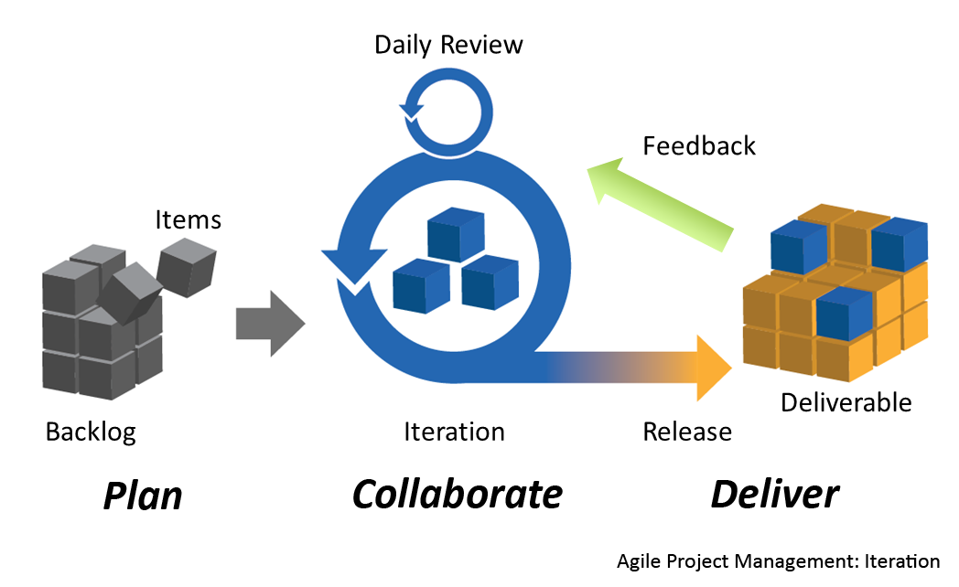
Methodology
Review
We review what we’ve done and entreat feedback from the client for further development
01
Deliver
We make a product fit to purpose for our client by the end
Planning
Lay out stages and deliverables, with room for changing requirements as the project progresses
03
04
Develop
Work on the various tasks to make a product that the client wants

Slide 8
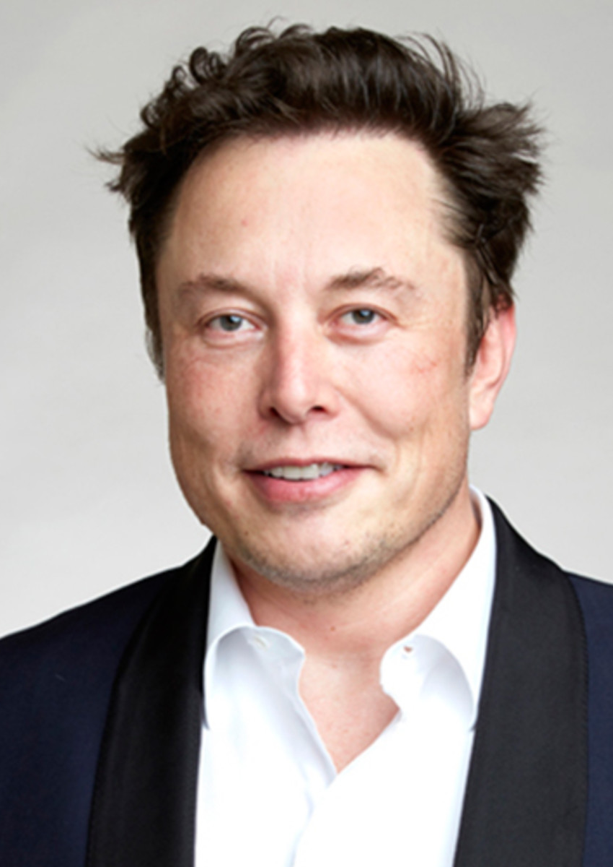
Risk
I’m increasingly inclined to think that there should be some regulatory oversight, maybe at the national and international level, just to make sure that we don’t do something very foolish. I mean with artificial intelligence we’re summoning the demon.
Elon Musk

Slide 9
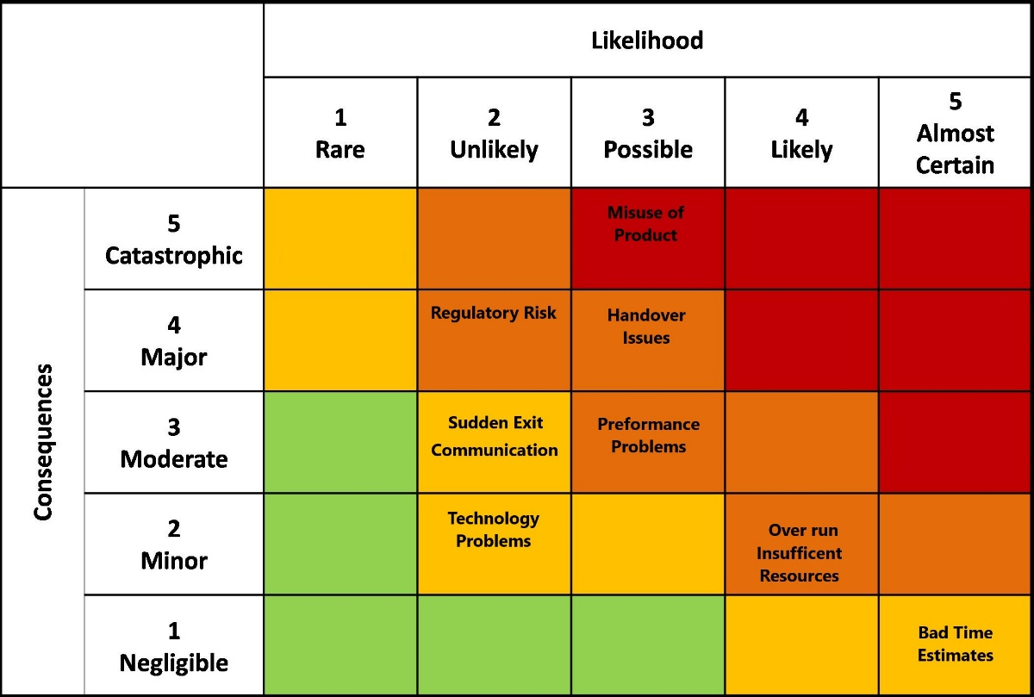
Risk Management
Handover
Misuse of Product
Documentation not understood by incoming team
Use of our developed product in an immoral or illegal fashion
Performance Issues
Regulatory Risk
Product not meeting standards for performance
Laws and regulations put in place that impact our project

Slide 10
Data Scraping
Python
Using Python to iterate over all the downloaded webpages and examine the content using Beautiful Soup
We had a number of problems to over come to achieve this, and many tools to use
Beautiful Soup
An HTML parser that lets you search though an HTML page by tag and other such methods, or retrieve all the text on a page without tags
Down Them All
A Firefox addon that downloads all the links on a page
Paclii Website
The website that has a database of publicly available cases for us to use as data

Slide 11
Data Filtering
Filter | Number of Files | Number Filtered
None | 8,196 | 0
Criminal Cases | 3,820 | 4,376
Murder Cases | 1,523 | 2,297
Sentencing | 1,051 | 472

Slide 12
Metadata Section
By Komal

Slide 13

Basics of Metadata
Basically it is "Data about data." It helps to make data findable & understandable.
Descriptive Metadata
Structural Metadata
Administrative Metadata

Slide 14
Implementation Of Metadata In Context Of PNG Judicial Process.
01
Read case file from PACLII website.
02
Manually checked individual case file source.
03
Derived knowledge under <title> tag. Which includes case number, date, month, year etc.
04
It`s still requires to collect keywords to derive accurate outcome at the end.

Slide 15
As it require to collect more specific content to feed AI to get accurate response while not compromising any aspect of law.
Current information is not enough to form good quality metadata specially it seems hard to collect any keywords.
As PNG is planning to use Synergy case management system, it can be beneficial to collect more structured data.
Future work

Slide 16
Website Development
Discussed by Michael

Slide 17
Website
Development
Idea of the website:
Website is a platform for the AI Engine
Website should be easy to use
Website looks professional

Slide 18

Python
Django
Why did we choose Django?
Flexible framework
Great for machine learning
Overwhelming amount of resources online
Well established and has a huge community online
Easy to pick up and learn
Picture from https://www.djangoproject.com/community/logos/

Slide 19
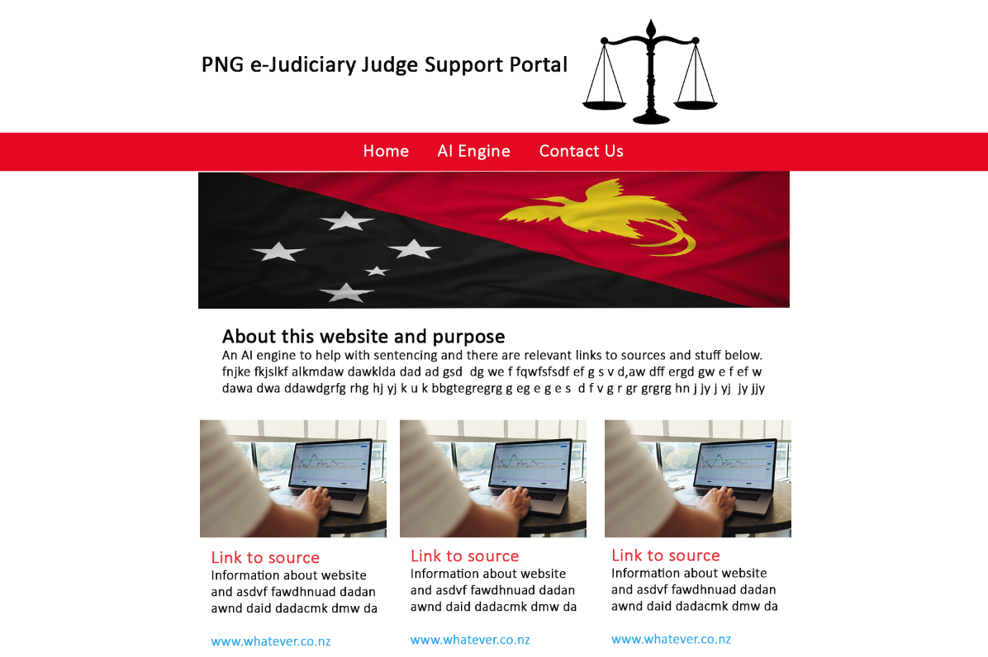
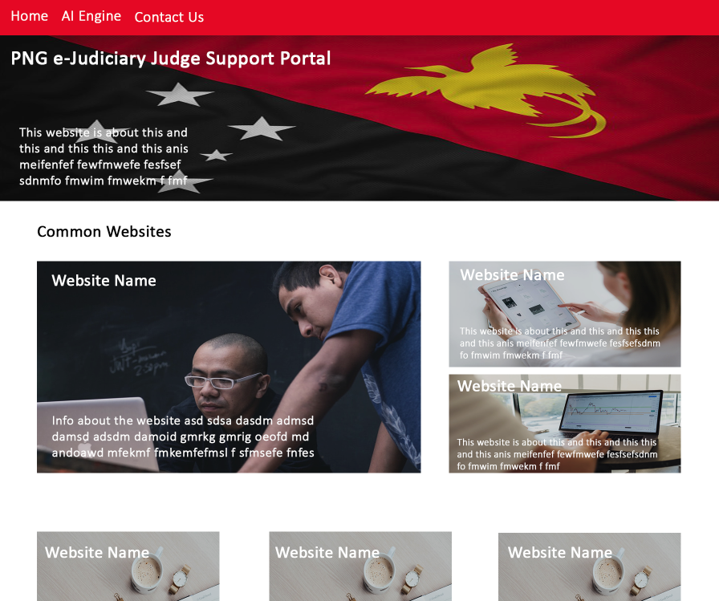
Website Design
After researching website designs and looking through websites the judges compiled for me, these were the designs I produced keeping in mind that it should be easy to use and look professional

Slide 20
Website Pages
01
Portal Page
This page is the home page and has links to several resources online
02
Portal Page
AI Engine Page
AI Engine page links to nueral network and users can use it through this page
AI Engine Page
03
About Us Page
Represents all the people who worked on this project and their roles
About Us Page

Slide 21
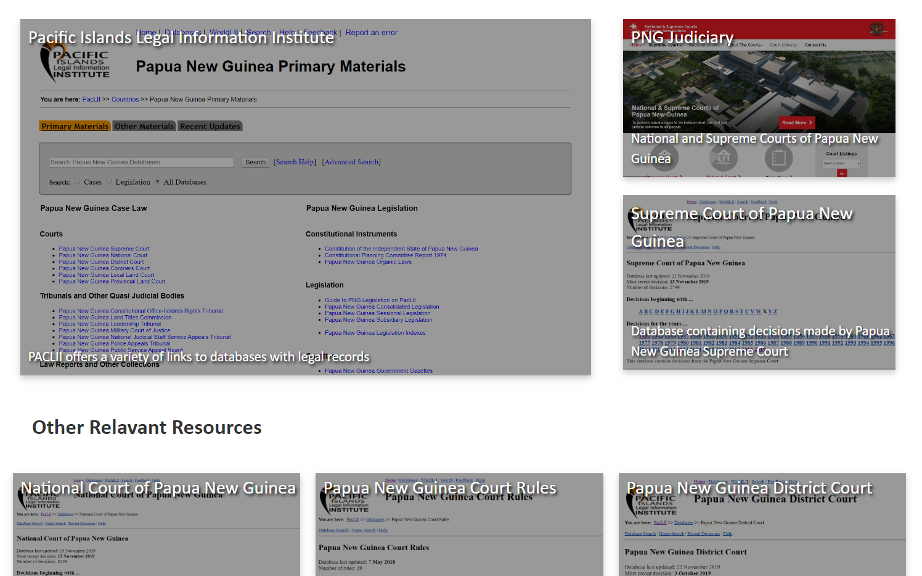
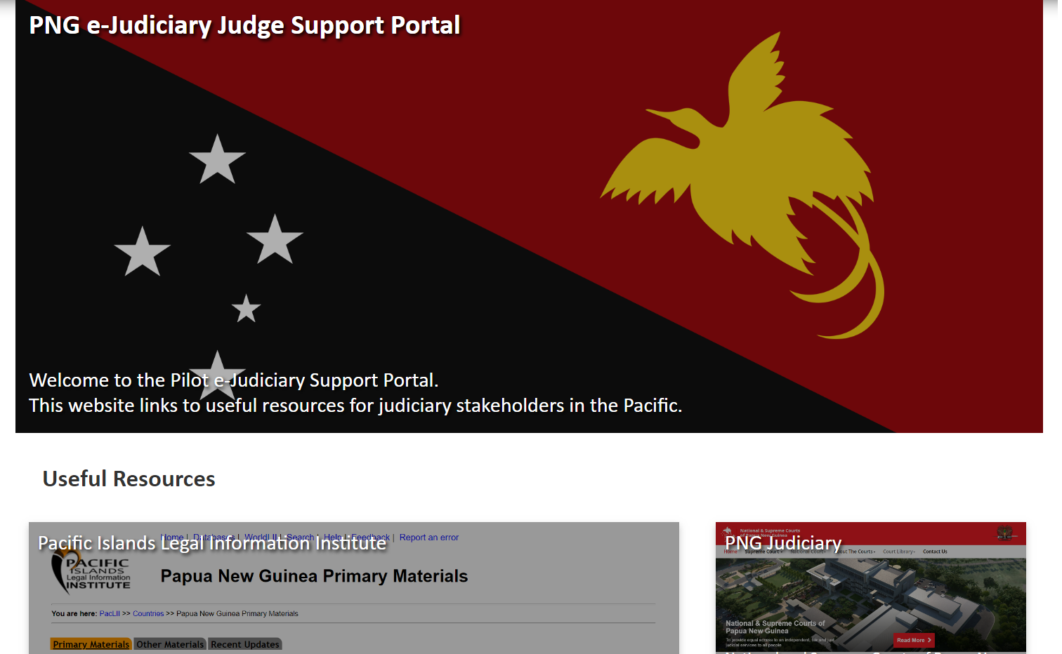
Portal Page
Main idea of this page is to have useful resources in one place

Slide 22
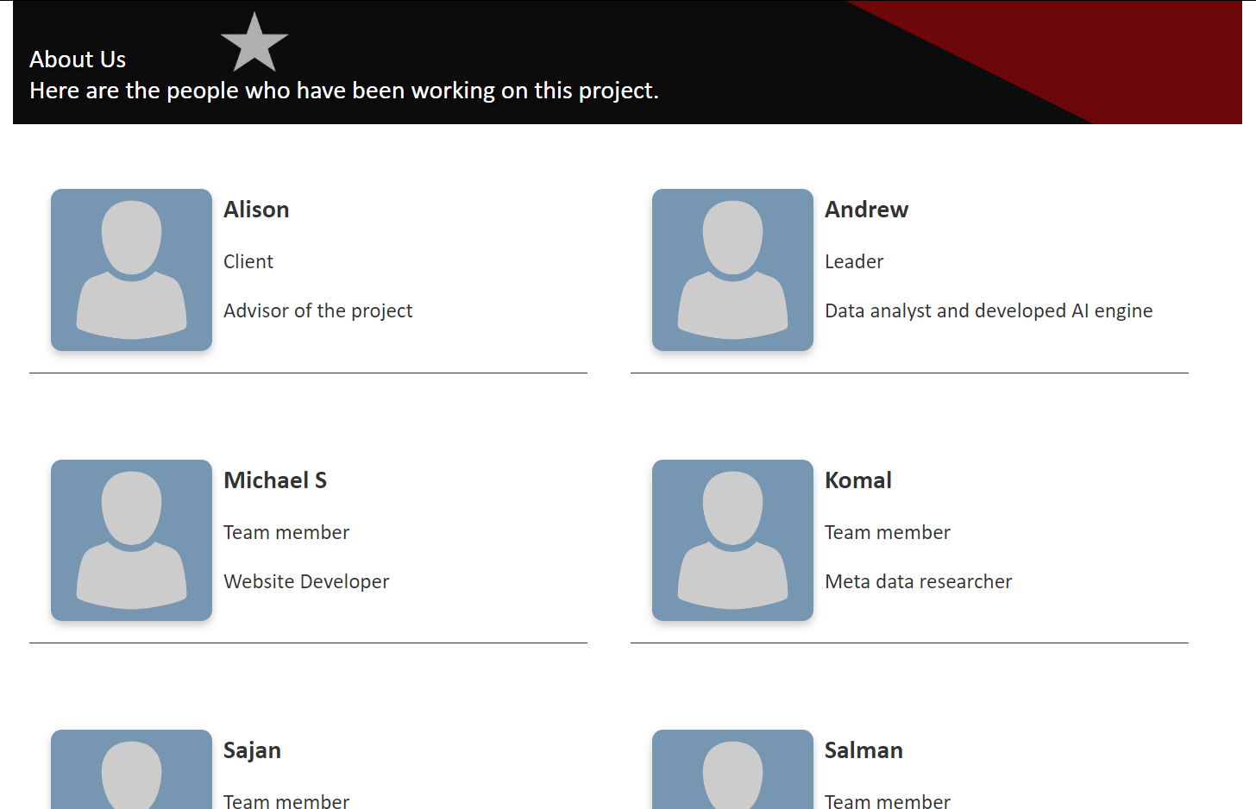
About Us Page
Giving credit to the people who worked on the project

Slide 23
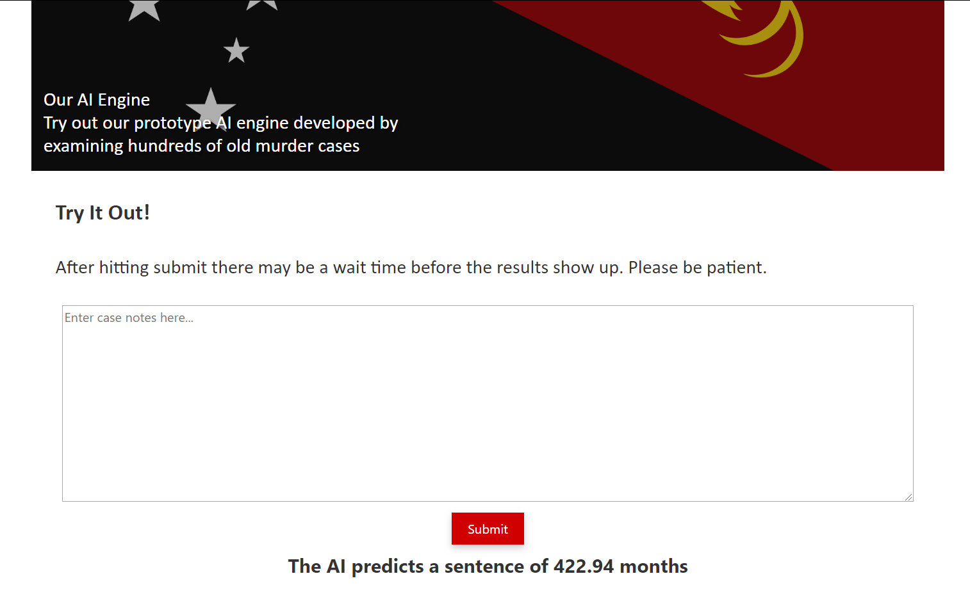
AI Engine Page
How to get information from user?
Use a text box for case notes
AI will then process and give output

Slide 24

Summary of Website Development
Overall website development went well
A few problems with setting up python environment and running scripts
Responsiveness unfinished
Website follows design
Website mainly consisting of HTML and CSS

Slide 25
AI Section
Andrew talks. A lot.

Slide 26
ARTIFICIAL
INTELLIGENCE
A Brief Introduction to AI
Term coined in 1956 at Dartmouth College
Expert systems developed in the 1980s from AI research
1997 – Deep Blue beats Garry Kasparov
2011~Present, development of Deep Learning with Neural Networks as AI

Slide 27
Basic Text Preprocessing
Lemmatizing, stemming
Converting words into base forms
Tokenization
Turning case files into a sequence of words (tokens)
Word Removal
Stop words, most common and least common.
~1.7 million removed from corpus (mostly stop words)
Basic Preprocessing
Lower case, removal of non-alphanumeric characters

Slide 28

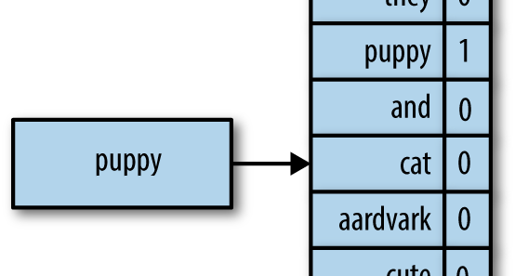
Bag of Words
Uses One-Hot Encoding
Each document in the corpus becomes a vector of the same length as the vocabulary

Slide 29
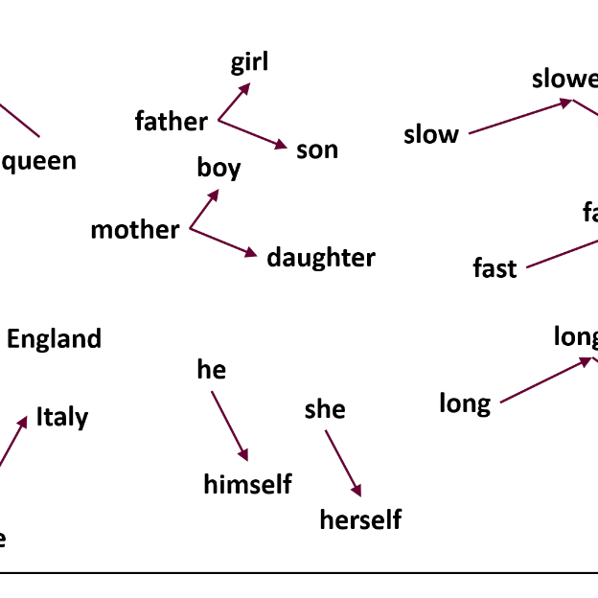
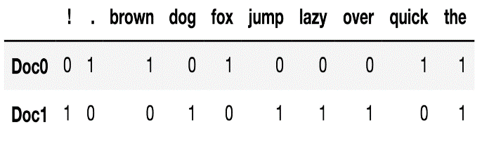
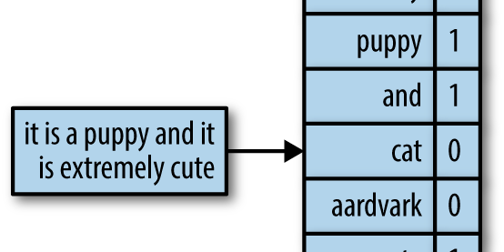
Word Embeddings
Count Vectorizer
Turns each document into a vector of word frequencies, and the word vector will be the length of the number of documents
Word2Vec
Pre-Trained vector space of words from Google, trained on 100 billion word corpus

Slide 30
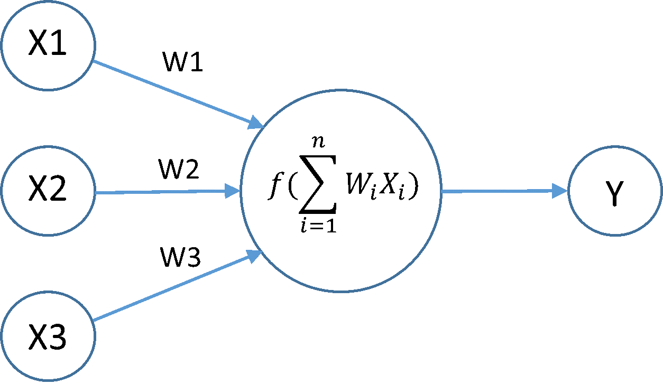
Neurons
The building block of Neural Networks
Each Neuron has:
Input
Input Weights
Activation Function f
Output

Slide 31

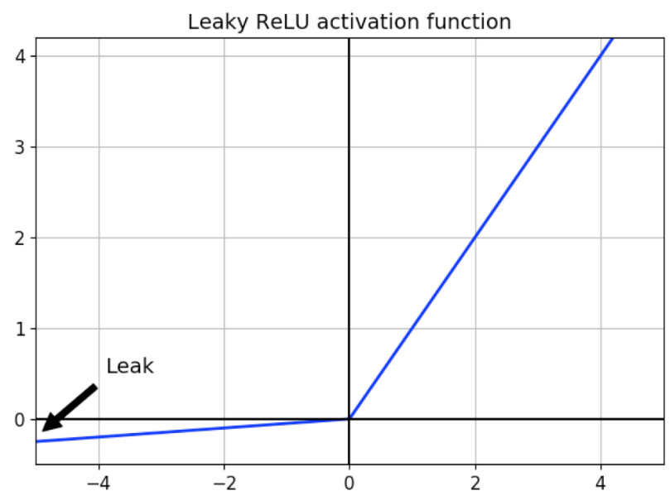
Activation Functions
Sigmoid
ReLU
Leaky ReLU
A simple non-linear function that squashes its input to a value between zero and 1
Rectified Linear Unit is an activation function that works well for many tasks in AI, as well as assisting with the Vanishing Gradient problem
Similar to ReLU but allows a small amount of negative value through

Slide 32
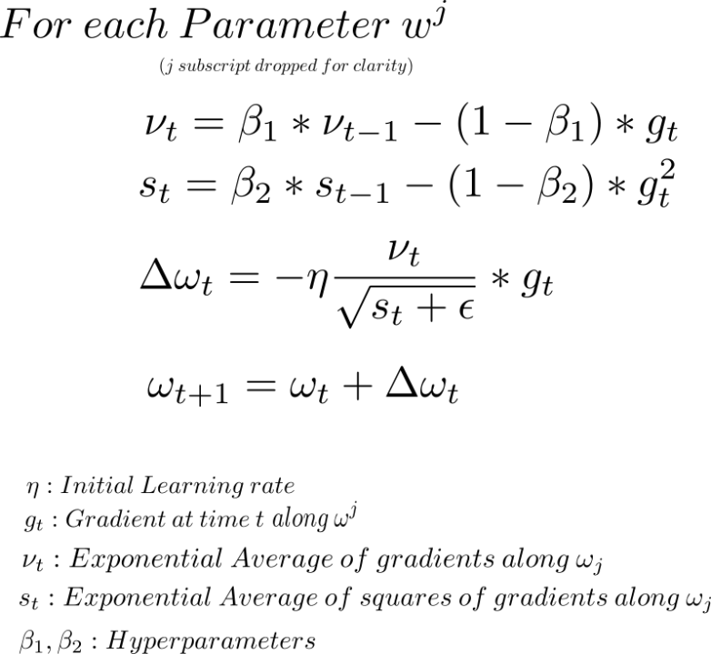
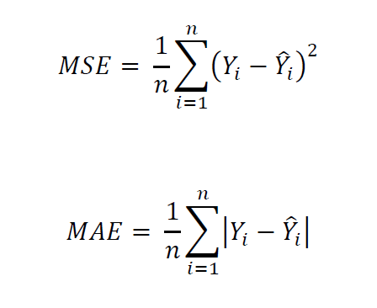
Optimizers and Loss
ADAM
Mean Absolute Error
Mean Squared Error
Good general purpose optimizer that converges quickly, though not always optimally
A common loss function for regression style problems
Default loss function for regression problems

Slide 33
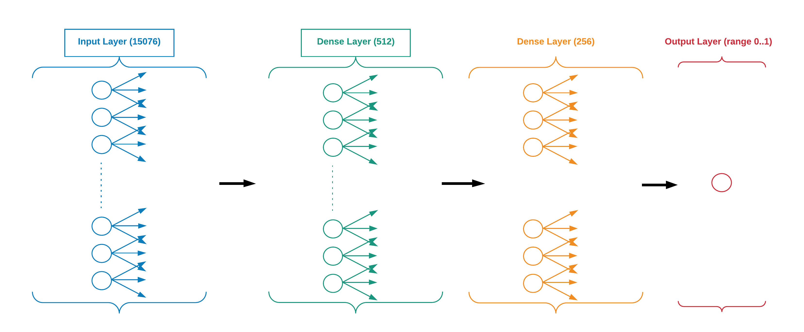
Count Vector Architecture

Slide 34
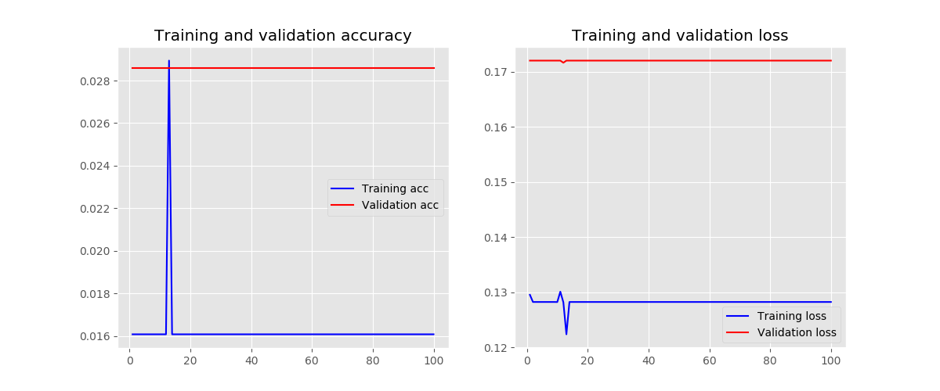
Count Vector Results

Slide 35
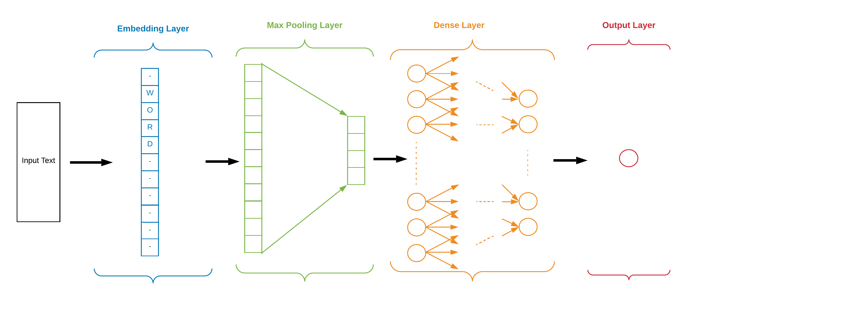
Embedding Architecture

Slide 36
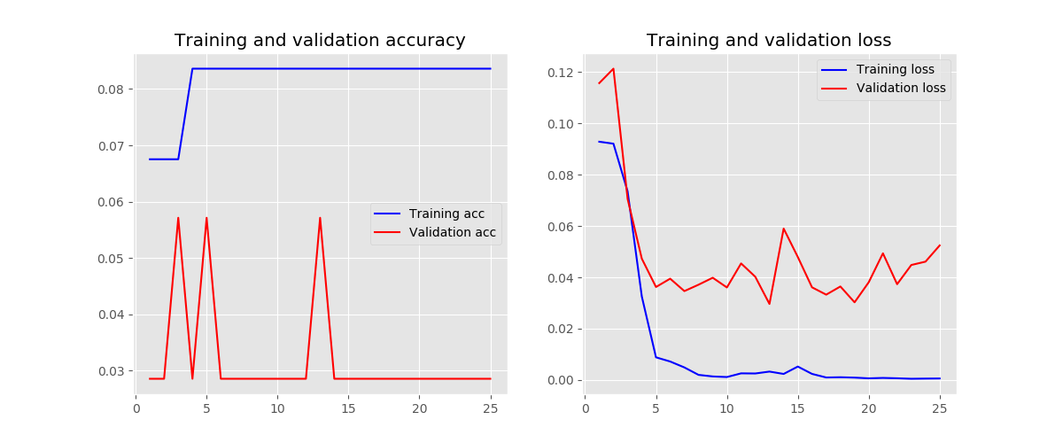
Embedding Results

Slide 37
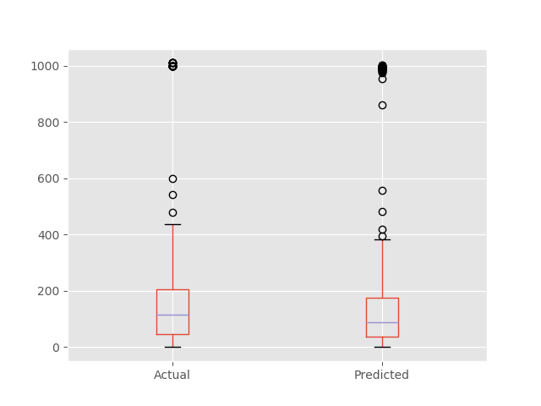
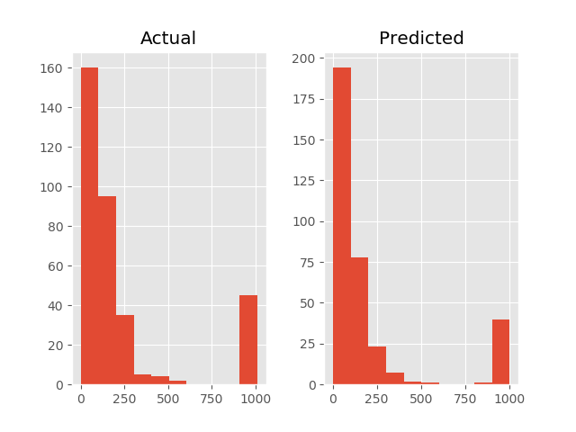
Embedding Results

Slide 38
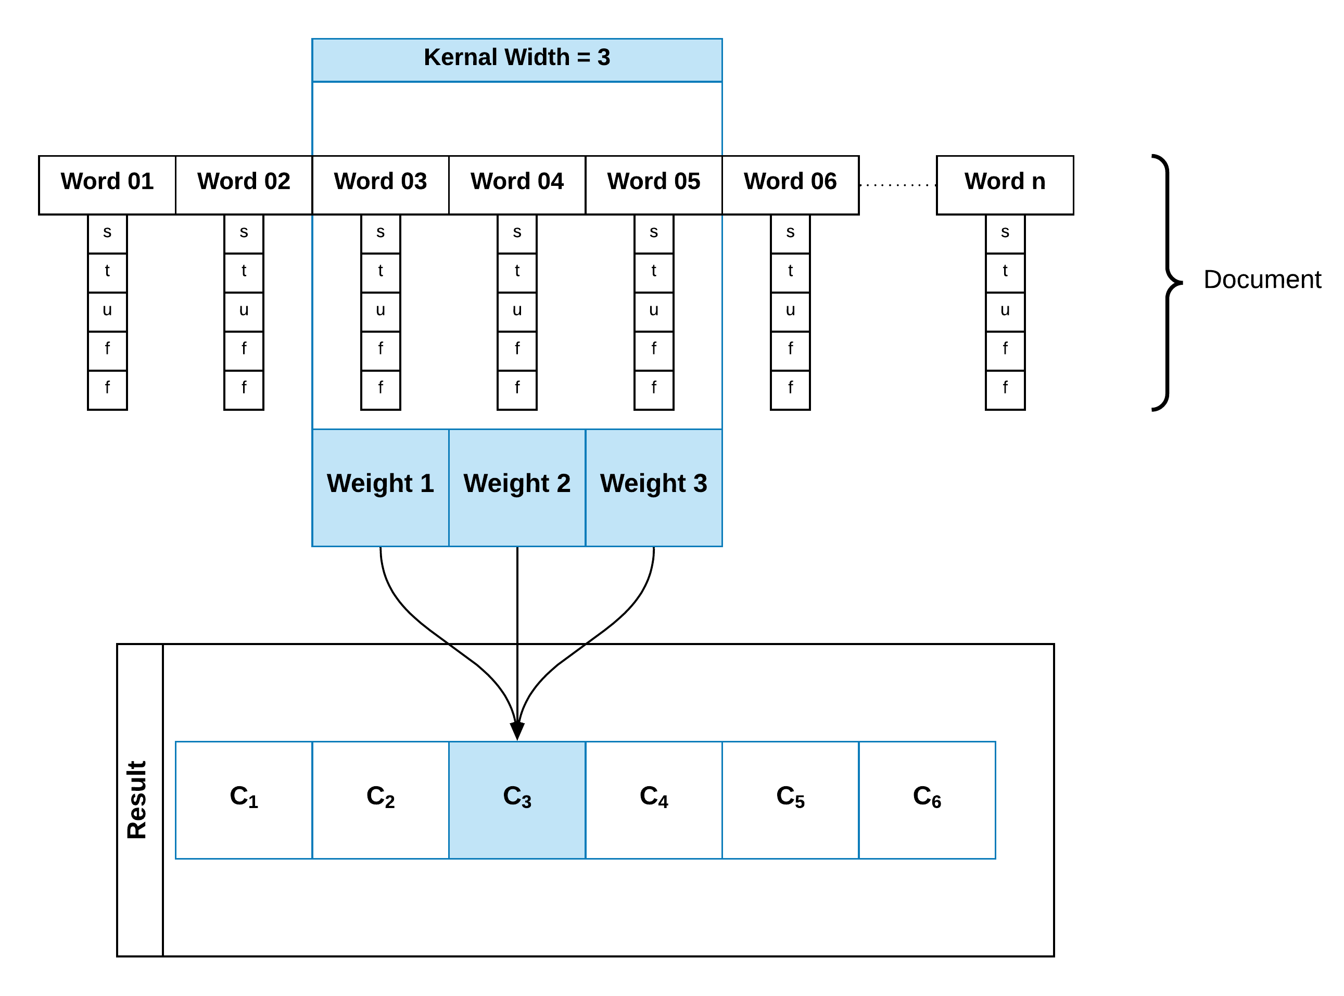
Convolutions

Slide 39
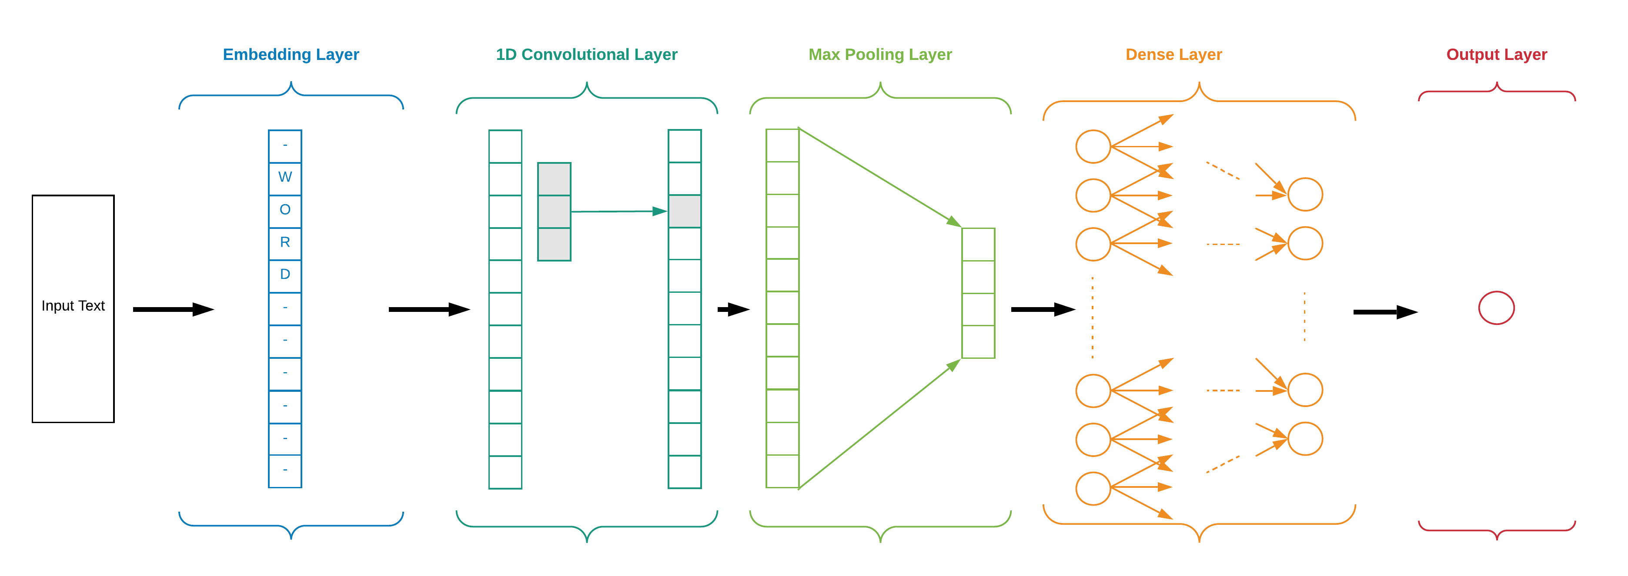
Word2Vec Architecture

Slide 40
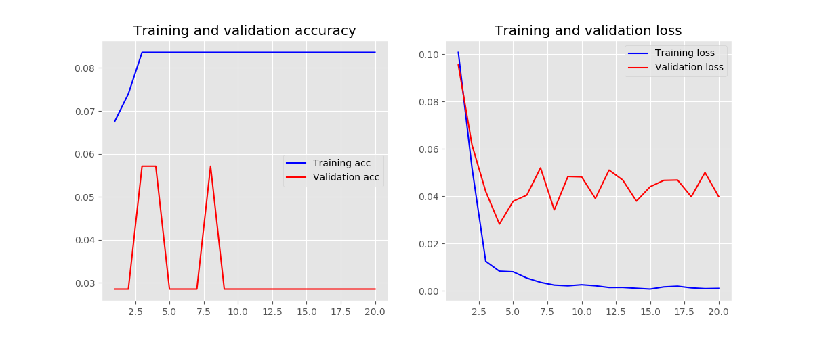
Word2Vec Results

Slide 41
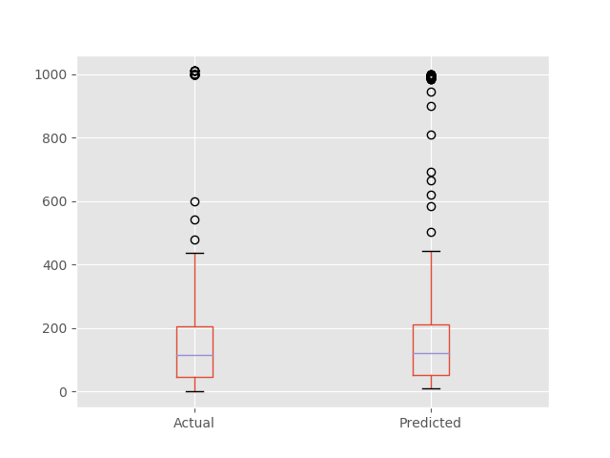
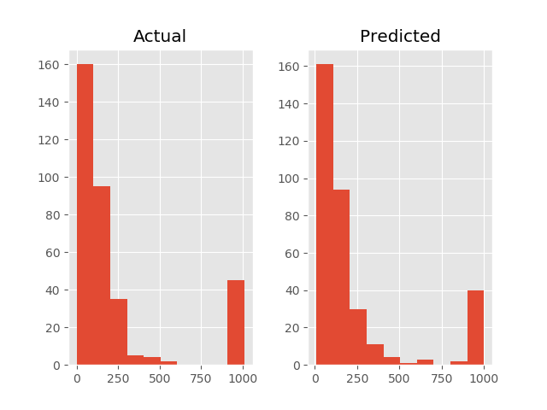
Word2Vec Results

Slide 42
Thank You
Time for a Demonstation

